Slide 1

AutoDoc:
AutoMobile Configuration Optimizer
AZAD KUMAR JHA
azadkumarjha09@gmail.com

Slide 2
Optimizing Car Configuration Testing using Predictive Model
Objective: To develop a predictive model that can optimize the testing process for multiple feature combinations in automotive systems.
Challenges:
Complex and time-consuming testing process.
Large number of possible configurations.
Need for efficiency and safety in production lines.
DataSet Link: https://www.kaggle.com/competitions/mercedes-benz-greener-manufacturing/data
Youtube Explaination Link:https: https://youtu.be/IUVqlQ889BI
Youtube Process Demo Link: https://youtu.be/GrGvZGF1VsI

Slide 3


Rapidminer Overview
Why RapidMiner?
Workflow in RapidMiner
User-friendly drag-and-drop interface.
All-encompassing machine learning platform.
Compatibility with various algorithms, including XGBoost.
Data Preprocessing: Cleaning and preparing data for model consumption.
Model Training: Efficiently building the XGBoost model within the RapidMiner platform.
Evaluation: Assessing the model's effectiveness through various metrics

Slide 4
Methodology
Importing Data: The process begins with importing the dataset into a data analysis tool or programming environment like RapidMiner. This step involves loading the data from its source, such as a database or a file.
Data Cleaning: After importing the data, the next step is to clean it. This involves identifying and handling missing values, duplicates, and any other inconsistencies in the data. Cleaning the data ensures that it is of high quality and suitable for analysis.
Data Analysis: Reviewed the dataset and analysed corelation with y by correlation matrix. Features with low correlation were filtered out using a predefined threshold to focus on more relevant variables. Tools like scatter plots and deviation graphs were used to visualize relationships between features and the target, uncovering patterns for better model performance.
Stage 1

Slide 5

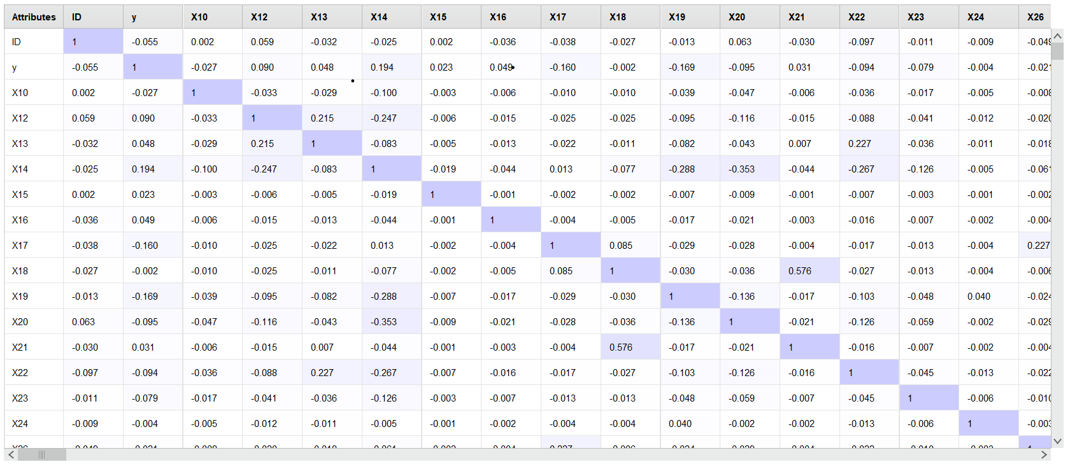
Data Analysis: Corelation Matrix

Slide 6
Methodology
Stage 2
Once the anonymized Mercedes car configuration dataset is loaded, preprocessing prepares it for analysis. Each variable represents a custom feature, while the target variable 'y' indicates the time (in seconds) the car took to pass testing.
Model Selection
XGBoost was chosen for its efficiency in handling large datasets with many features. Its gradient-boosting approach learns from weak models, improving prediction accuracy iteratively. The model:
Prioritizes Feature Importance: Identifies key features influencing testing time.
Minimizes Error: Refines predictions to reduce testing time errors.
Handles Feature Interactions: Effectively manages complex relationships between car features.

Slide 7
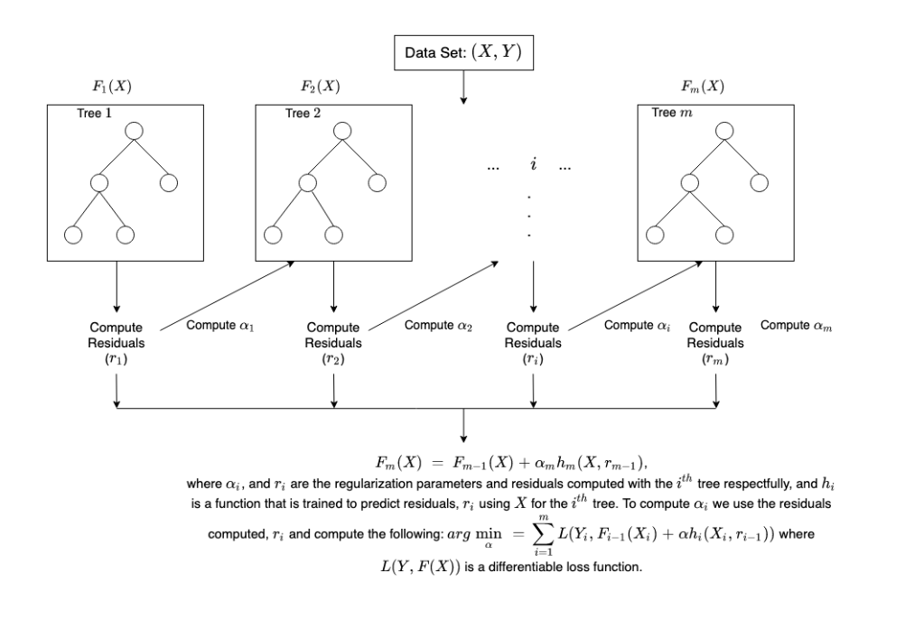
XGBoost Structure
.

Slide 8
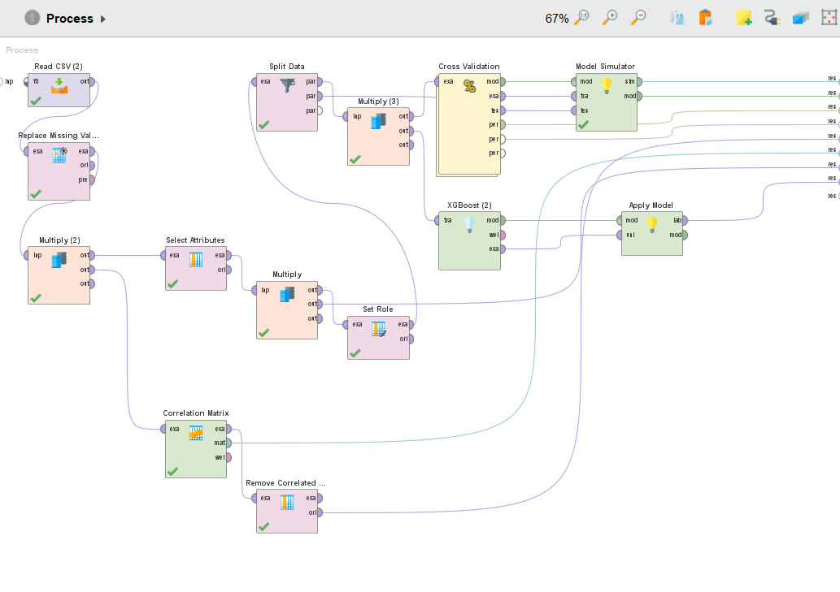
Rapidminer Process Design Layout

Slide 9
Methodology
Stage 3
Cross-Validation
A k-fold cross-validation was used to prevent overfitting and validate the model’s performance across different subsets of the data. This helped ensure the model generalizes well to unseen data.
Model Evaluation
Tested the model’s performance on unseen data (test set).
Appiled the trained XGBoost model to the test dataset.
Measured key performance metrics (accuracy, precision, recall, F1-score, RMSE, MAE for regression).
Analyzed results using confusion matrix or error metrics, and identify underperforming areas.
Performance metrics on test data and insights into model accuracy and generalizability.

Slide 10
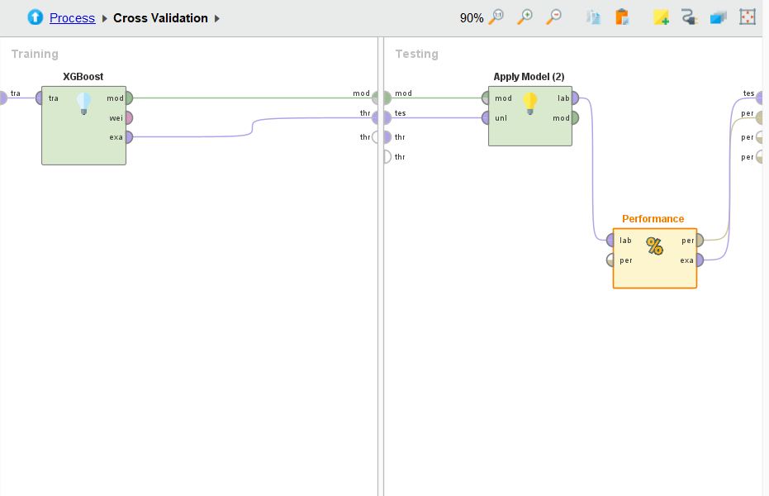
Cross Validation Layout

Slide 11
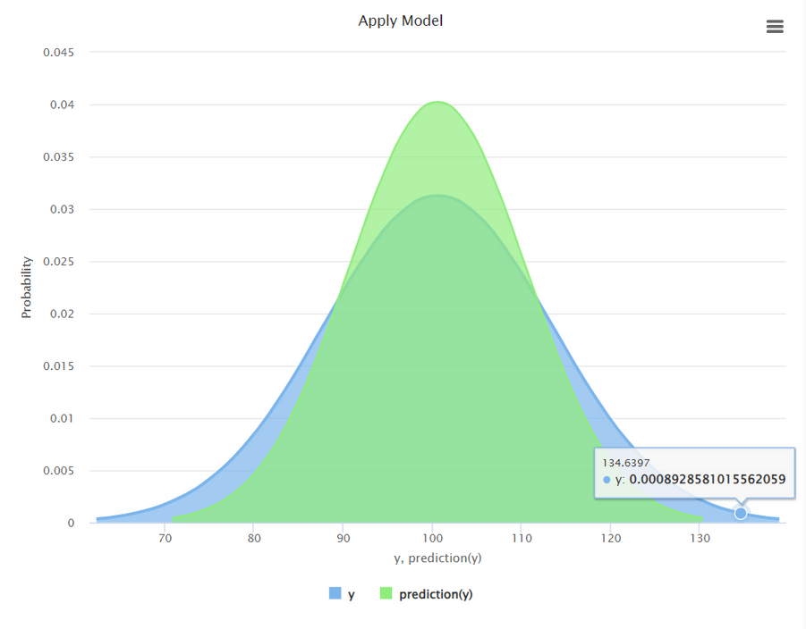
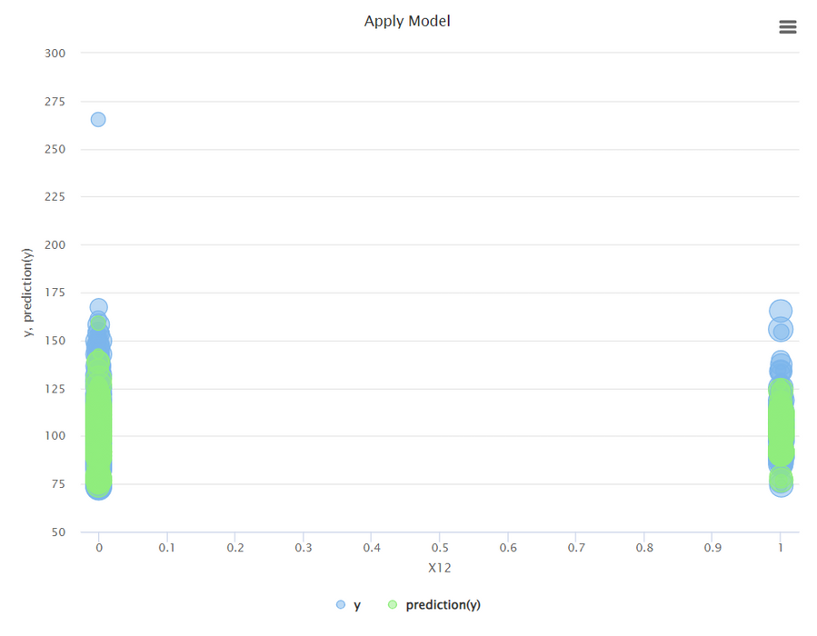
Data Analysis: Graphs
Probability Density Graph
Scatter Plot

Slide 12
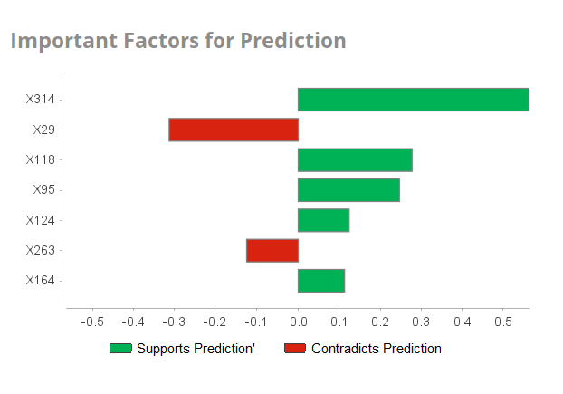
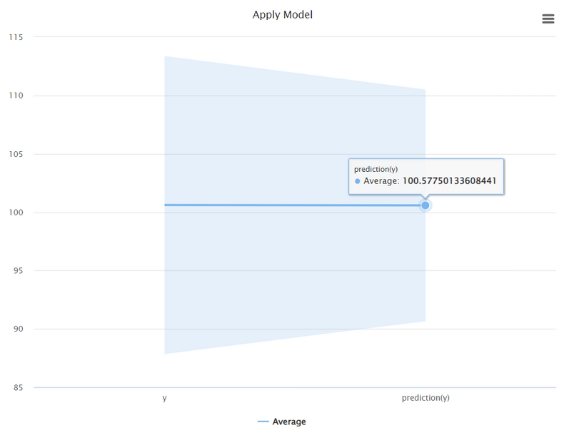
Data Analysis: Graphs
Corelating Variables
Deviation Comparison

Slide 13
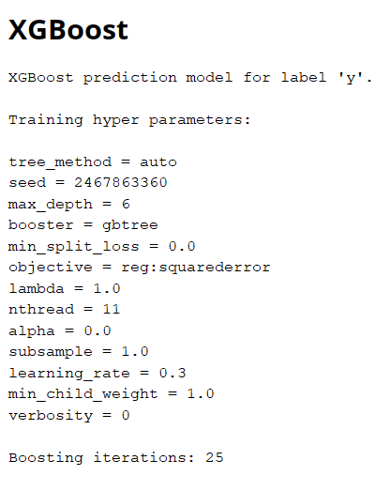
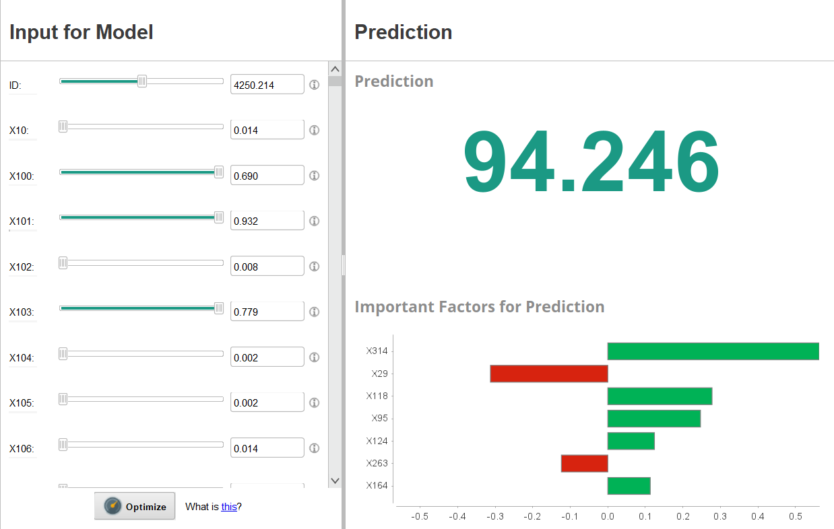
Model Evaluation

Slide 14
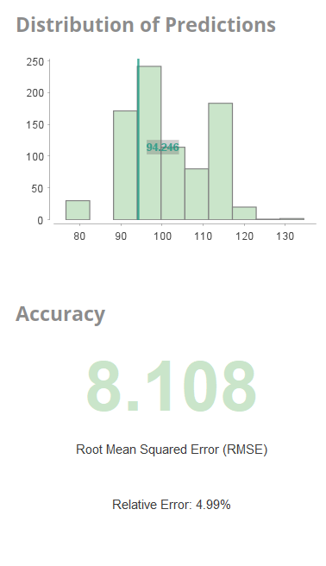
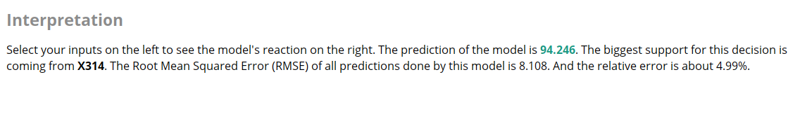
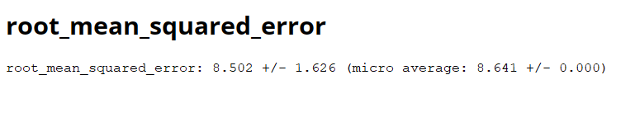
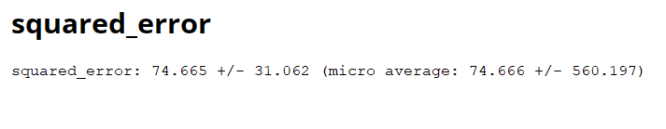
Model Evaluation

Slide 15
Thank You

